Slide 1
Subtype Identification and Clustering of single-cell RNA-seq data by nearest neighbor searching
Zhixin Li
July 13, 2018
Notes:
Module-based

Slide 2
Overview
Current clustering method for scRNAseq and limitations
Hypothesis and Inspiration
Algorithm of MSIC
Performance on simulated dataset
Application in real cases
Conclusions

Slide 3
Clustering on scRNA-seq
Why clustering is so important for scRNA-seq? heterogeneity
Notes:
Recent studies demonstrate that de novo cell type discovery of functionally distinct cell subpopulations is possible via the unbiased analysis of scRNA-seq data2–4.
A key advantage of single-cell RNA sequencing (scRNA-seq) is that it can be used to determine cell types in an unbiased way by submitting transcriptomes to unsupervised clustering1–3.

Slide 4
Current clustering method and their limitations
SC3
SIMLR
Seurat
T-SNE & k-means
Need to choose a k for clustering
Need to do feature selection before clustering
Can avoid some confounding genes (cell cycle, apoptosis)
Consume a lot of computing resources

Slide 5
Hypothesis: Marker types (MTs)
MT1 – uniquely expressed genes with the same expression level
MT1-neg – negative markers of MT1
MT1’ – uniquely expressed genes with different expression levels
MT1’’ – uniquely expressed genes synergistic change across cells
MT2- intermediate – intermediate genes between two subtypes
MT3 – highly expressed genes in certain subtypes
MT4 – genes with gradually rising/falling expression

Slide 6
Simulated data
MT1 – uniquely expressed genes with the same expression level
MT1-neg – negative markers of MT1
MT1’ – uniquely expressed genes with different expression levels
MT1’’ – uniquely expressed genes synergistic change across cells
MT2- intermediate – intermediate genes between two subtypes
MT3 – highly expressed genes in certain subtypes
MT4 – genes with gradually rising/falling expression
Biological insights
Genes
Cells

Slide 7
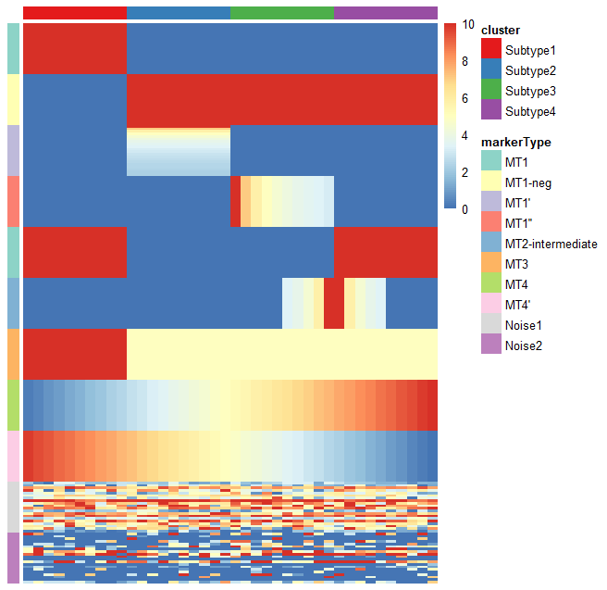
Simulated data
MT1 – uniquely expressed genes with the same expression level
MT1-neg – negative markers of MT1
MT1’ – uniquely expressed genes with different expression levels
MT1’’ – uniquely expressed genes synergistic change across cells
MT2- intermediate – intermediate genes between two subtypes
MT3 – highly expressed genes in certain subtypes
MT4 – genes with gradually rising/falling expression
Biological insights
Genes
Cells
Notes:
However, there is also a large amount of technical and biological noise. Because of the low number of RNA transcriptomes and the stochastic nature of the gene expression pattern, there is a high chance of missing nonzero entries as zero, which are called dropout events.

Slide 9
Inspiration
New strategy for scRNA-seq clustering
Correlation between the genes in the same marker module is higher.
Can we identify all the marker modules first and then using them to do the clustering?

Slide 10
Core hypothesis
marker modules locate in the local centers (gene clusters with high density) in the gene-gene correlation network.
Then marker module identification is a question of local center identification.
Slicing and scanning method can effectively detect the local center of a network.
Subtypes can be inferred by the marker modules.

Slide 11
MSIC overview
Cell outlier detection
Build gene-gene correlation network
Identify local centers of the network
Infer and classify all the marker modules
Infer all the subtypes in the cell group

Slide 12
Outlier
Classical version: observations lying “far away” from the main part of a dataset and probably not following the assumed model (Becker and Gather, 1999).
Single cell version: cells far away from any subgroups in a heterogeneous cell population. p >> n (p denotes feature count, n denotes sample size).
Purpose: removing the extreme outliers far away from any cells and keep the rare cell populations.
Notes:
Correlation is the basic for further analysis.
Correlation, especially Pearson correlation, is very sensitive to strong outliers.

Slide 13
Extreme Outlier detection
Method: dimension reduction (PCA) + Kth nearest neighbors
dimension reduction: remove noisy features
Kth nearest neighbors: keep rare cell populations
Notes:
why removing outlier is necessary? using simulated data to explain this point
why current outlier detection method is not suitable? use ground truth to demonstrate this point, compare different tools (removing the rare populations)
why using dimension reduction (cite paper)? top 100 or 95% explained variance PCs
try different dimension reduction method (PCA and DM), compare the results
outlier detection algorithm, minNum

Slide 14
Outlier detection algorithm (PCA)

Slide 17
deng
pollen

Slide 18
Notes:
Few outlier will not affect the correlation

Slide 19
Effect of outliers on correlation
Add outliers, check correlation.
How to judge the exist of outlier?
How our method can keep rare population.

Slide 20
Why using correlation?

Slide 21
Local center identification algorithm
nearest neighbors searching

Slide 22
Subtypes inference

Slide 23
Performance on simulated dataset
How to simulate scRNA-seq dataset?

Slide 24
Performance on real dataset
Smart-seq
10x genomics

Slide 25
Co-expresssion network analysis
Improvements

Slide 26
Time consumption comparison

Slide 27
Key advantages - conclusion
No need to choose a k for clustering
No need to do feature selection
Can identify negative markers
Can identify the intermediate subgroup
Can identify rare subgroup
Greatly reduce the computing resource (at least 10 folds)
More intuitive strategy
Great benefit for downstream analysis

Slide 28
To do
Write a paper
Write a R package (submit to Bioconductor)

